Slide 1
XSS Lab

Slide 2
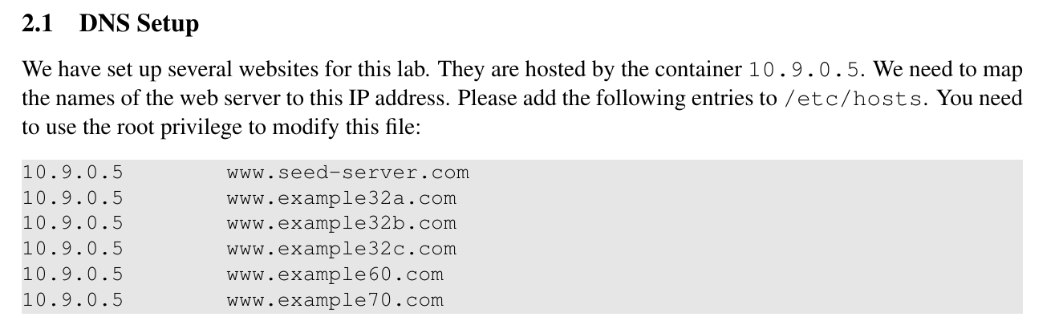
Preparation Elgg website
Set DNS records for the social network website.

Slide 3

Get Familiar with XSS
Task 1: Inject script to your profile
Directly set your profile info to script tag
Task 2 & 3: Steal cookie by XSS
Change your profile to the script tag
It encodes cookie into GET request query string
You may receive the request with nc (similar to buffer overflow lab)

Slide 4
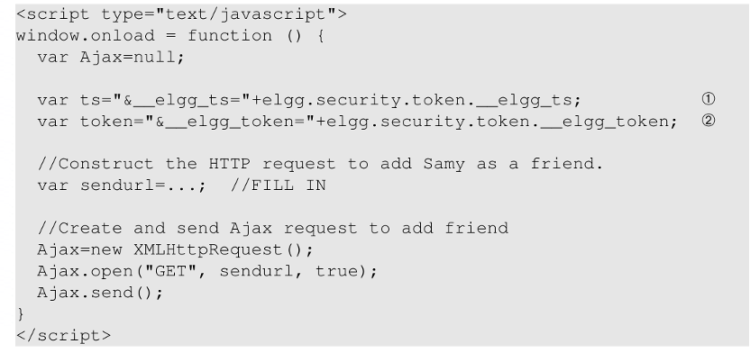
Task 4: XSS to add friend
Try to inject codes to add a victim as your friend, by forging AJAX requests.
What does ts and token do?

Slide 5
Task 5 & 6: Make a XSS Worm
Task 5: Modify the victim’s profile
By forging a POST request.
Task 6: Self-Propagate
Firstly put codes for task 4 in the profile to add Samy as friend.
Then use the code of task 5 to change the profile to the script itself.

Slide 6
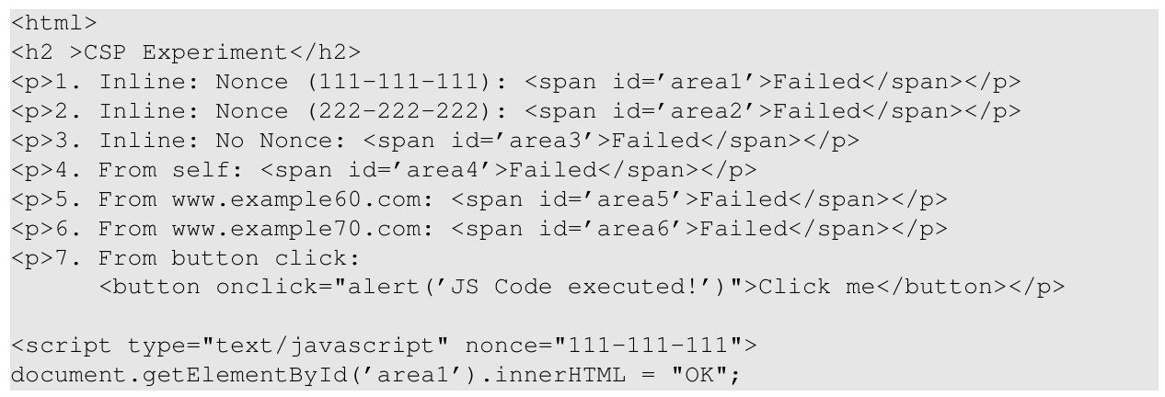
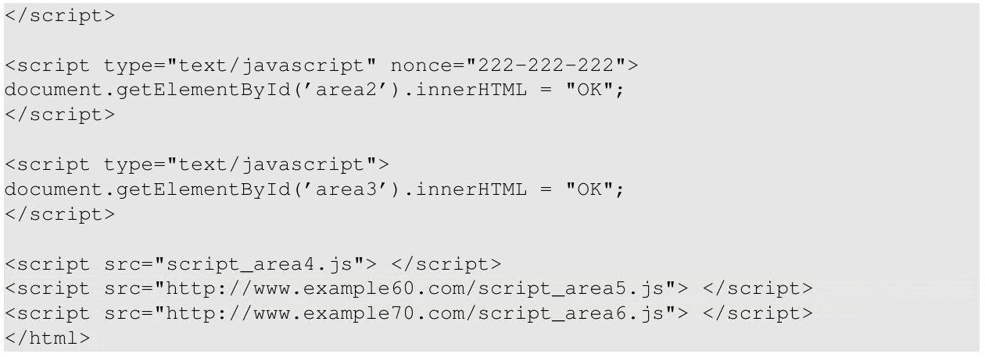
Task 7 CSP
Script from different sources:
Inline scripts with different nonces
Script from different domains.

Slide 7
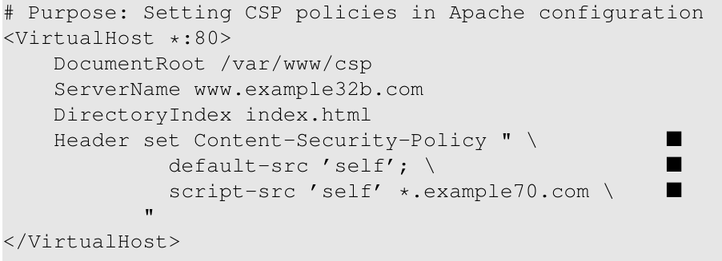
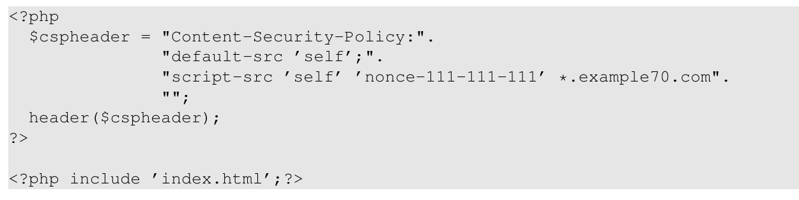
Task 7 CSP
Set CSP policy to restrict the source of JS.
By Apache virtual host settings.
By PHP
So some js codes may not work, and failed will be displayed.

